Slide 1
PYTHON PROGRAMMING
23-08-2023
Krunal Kshirsagar

Slide 2
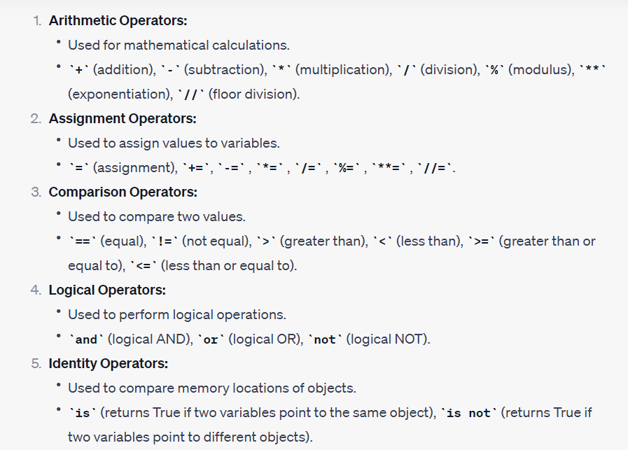
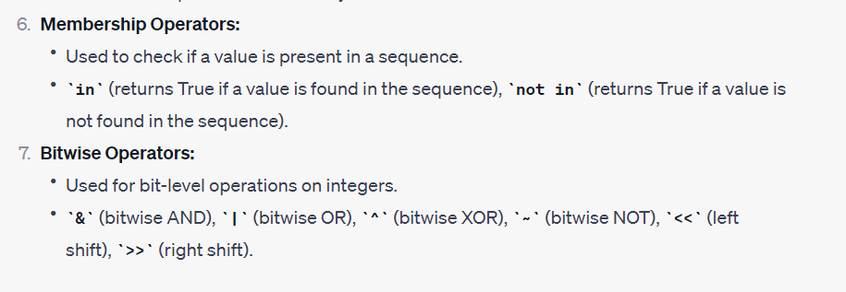
Operators

Slide 3
Agenda
Difference between List, Tuple, Set, Dictionary
Basic control structures
Demo Programs
Variables Scope
Introduction to functions

Slide 4
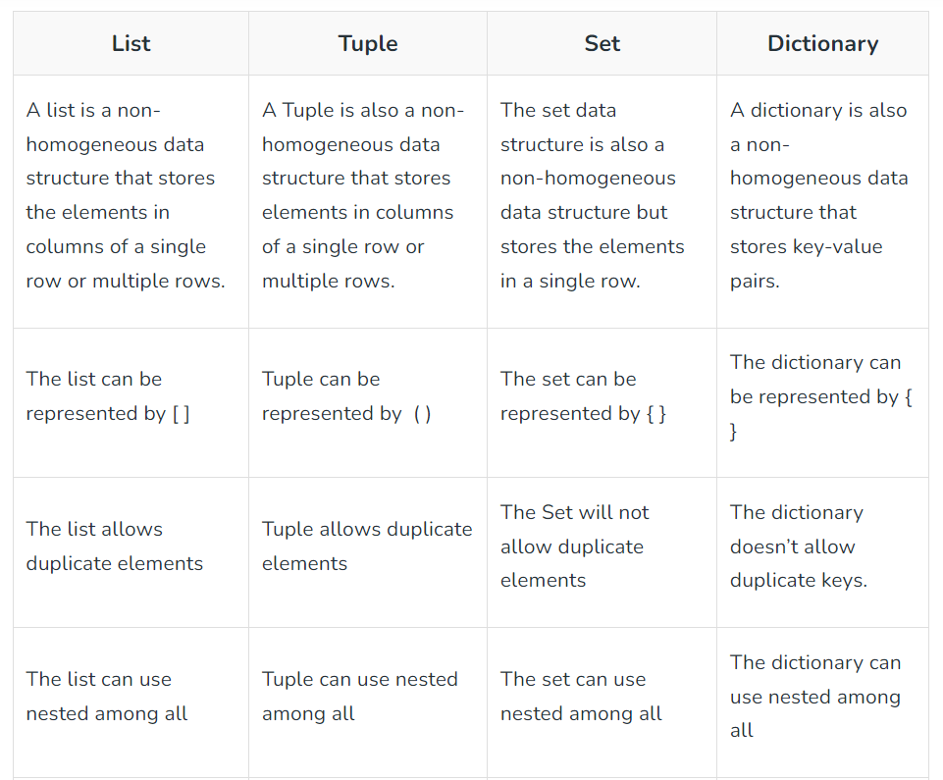
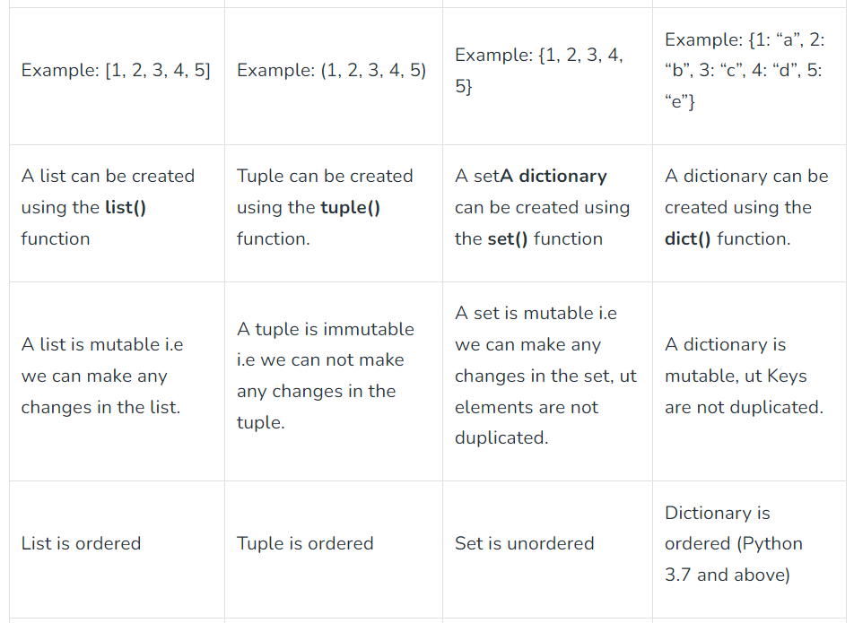
Difference between List, Tuple, Set, Dictionary

Slide 5

Basic Control Structures – IF, ELSE IF, FOR, WHILE LOOP

Slide 6
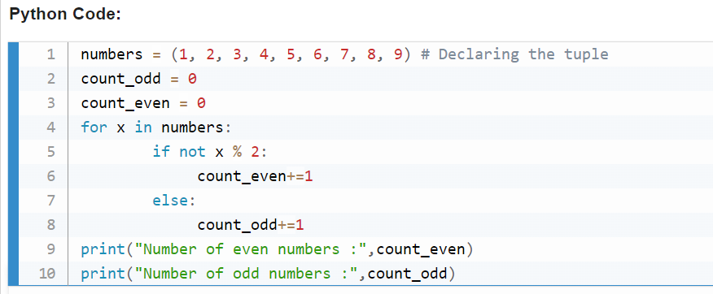
Count the number of even and odd numbers from a series of numbers

Slide 7
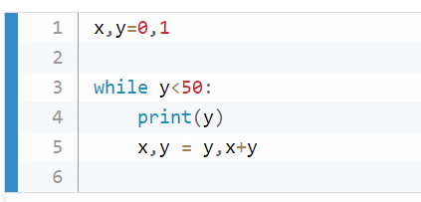
Fibonacci series between 0 to 50

Slide 8
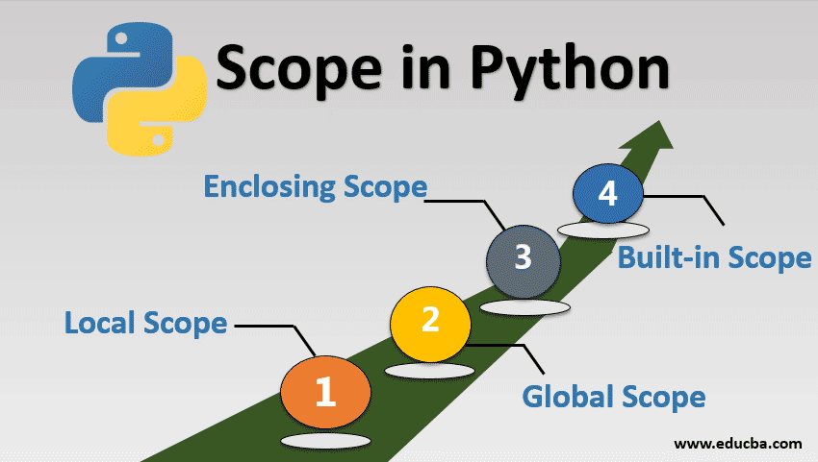

Slide 9
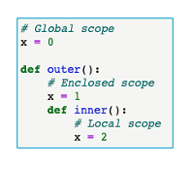

Slide 10
Functions in Python
Defining, Calling, Parameters, and Return Values

Slide 11
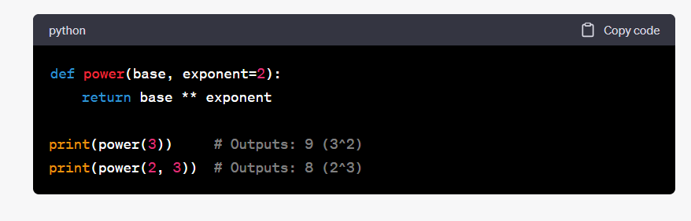

Slide 12
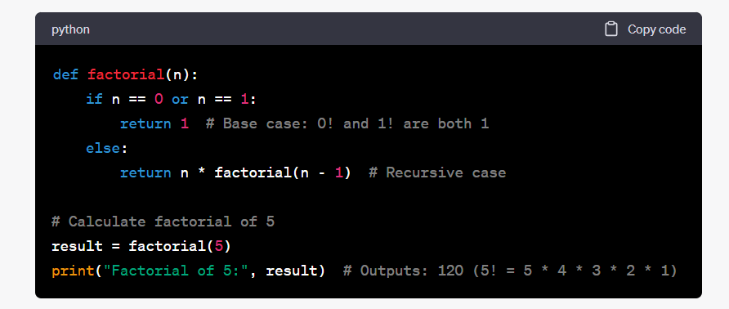
Recursive Functions in Python

Slide 13
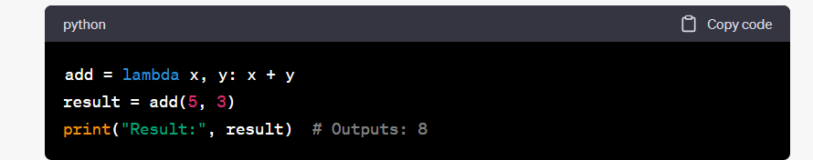
Lambda Functions in Python

Slide 14
Interview Trick Questions
Can we return more than one value?
Can we return a None value?
Can a function have multiple return statements?
What happens when you return multiple values separated by commas in a function? - Tuple
Can a lambda function have multiple expressions? - No
What's the difference between a local and global variable with the same name in a function?
What is *args and **kwargs
What is the difference between deep copy and shallow copy?

Slide 15
Thanks!

